Slide 1
Module 9: Virtual Memory
Background
Demand Paging
Performance of Demand Paging
Page Replacement
Page-Replacement Algorithms
Allocation of Frames
Thrashing
Other Considerations
Demand Segmenation
Operating System Concepts

Slide 2
Background
Virtual memory – separation of user logical memory from physical memory.
  Only part of the program needs to be in memory for execution.
  Logical address space can therefore be much larger than physical address space.
  Need to allow pages to be swapped in and out.
Virtual memory can be implemented via:
  Demand paging
  Demand segmentation
Operating System Concepts

Slide 3
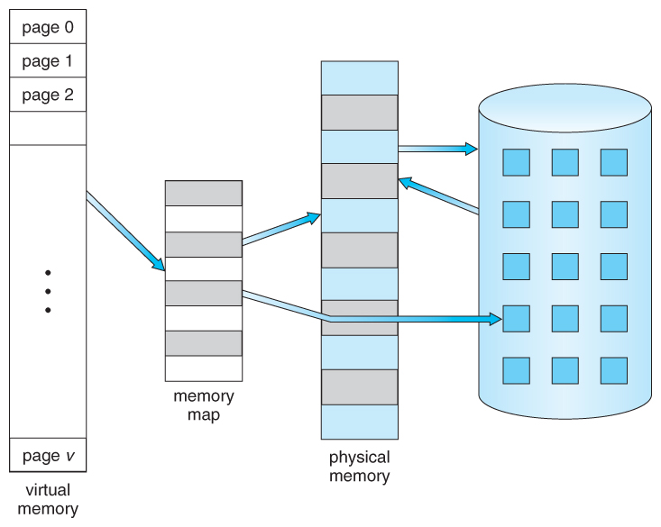

Virtual Memory larger than physical Memory
Operating System Concepts

Slide 4
Demand Paging
Bring a page into memory only when it is needed.
  Less I/O needed
  Less memory needed
  Faster response
  More users
Page is needed ⇒ reference to it
  invalid reference ⇒ abort
  not-in-memory ⇒ bring to memory
Operating System Concepts

Slide 5
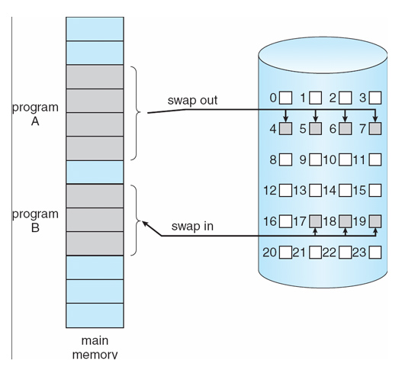
Demand Paging
Operating System Concepts

Slide 6
Valid-Invalid Bit
With each page table entry a valid–invalid bit is associated
(1 ⇒ in-memory, 0 ⇒ not-in-memory)
Initially valid–invalid but is set to 0 on all entries.
Example of a page table snapshot.
During address translation, if valid–invalid bit in page table entry is 0 ⇒ page fault.
Frame #
valid-invalid bit
1
1
1
1
0

0
0
page table
Operating System Concepts

Slide 7
Page Fault
If there is ever a reference to a page, first reference will trap to
OS ⇒ page fault
OS looks at another table to decide:
  Invalid reference ⇒ abort.
  Just not in memory.
Get empty frame.
Swap page into frame.
Reset tables, validation bit = 1.
Restart instruction: Least Recently Used
  block move
  auto increment/decrement location
Operating System Concepts

Slide 8
What happens if there is no free frame?
Page replacement – find some page in memory, but not really in use, swap it out.
  algorithm
  performance – want an algorithm which will result in minimum number of page faults.
Same page may be brought into memory several times.
Operating System Concepts

Slide 9
Performance of Demand Paging
Page Fault Rate 0 ≤ p ≤ 1.0
  if p = 0 no page faults
  if p = 1, every reference is a fault
Effective Access Time (EAT)
EAT = (1 – p) x memory access
+ p (page fault overhead
+ [swap page out ]
+ swap page in
+ restart overhead)
Operating System Concepts

Slide 10
Demand Paging Example
Memory access time = 1 microsecond
50% of the time the page that is being replaced has been modified and therefore needs to be swapped out.
Swap Page Time = 10 msec = 10,000 msec
EAT = (1 – p) x 1 + p (15000)
1 + 15000P (in msec)
Operating System Concepts

Slide 11
Page Replacement
Prevent over-allocation of memory by modifying page-fault service routine to include page replacement.
Use modify (dirty) bit to reduce overhead of page transfers – only modified pages are written to disk.
Page replacement completes separation between logical memory and physical memory – large virtual memory can be provided on a smaller physical memory.
Operating System Concepts

Slide 12
Page-Replacement Algorithms
The target for all algorithms is to reduce number of page faults.
A page fault is a type of interrupt, raised by the hardware when a running program accesses a memory page that is mapped into the virtual address space, but not loaded in physical memory.
Evaluate algorithm by running it on a particular string of memory references (reference string) and computing the number of page faults on that string.
In all our examples, the reference string is
1, 2, 3, 4, 1, 2, 5, 1, 2, 3, 4, 5.
Operating System Concepts

Slide 13
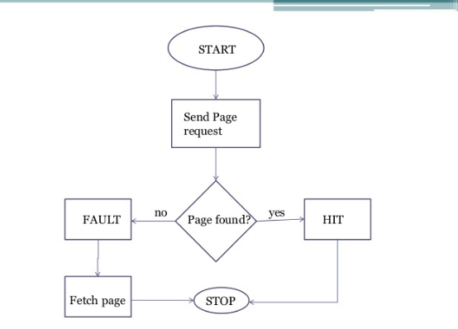
Page-Replacement Algorithms
Operating System Concepts

Slide 14
First-In-First-Out (FIFO) Algorithm
Reference string: 1, 2, 3, 4, 1, 2, 5, 1, 2, 3, 4, 5
3 frames (3 pages can be in memory at a time per process)
4 frames
FIFO Replacement – Belady’s Anomaly
  more frames ⇒ less page faults
1
1
4
5
2
2
1
3
9 page faults
3
3
2
4
1
1
5
4
2
2
1
5
10 page faults
3
3
2
4
4
3
Operating System Concepts

Slide 15
Optimal Algorithm
Replace page that will not be used for longest period of time.
4 frames example
1, 2, 3, 4, 1, 2, 5, 1, 2, 3, 4, 5
How do you know this?
Used for measuring how well your algorithm performs.
1
4
2
6 page faults
3
4
5
Operating System Concepts

Slide 16
Least Recently Used (LRU) Algorithm
Reference string: 1, 2, 3, 4, 1, 2, 5, 1, 2, 3, 4, 5
Counter implementation
  Every page entry has a counter; every time page is referenced through this entry, copy the clock into the counter.
  When a page needs to be changed, look at the counters to determine which are to change.
1
5
2
3
5
4
4
3
Operating System Concepts

Slide 17
LRU Algorithm (Cont.)
Stack implementation – keep a stack of page numbers in a double link form:
  Page referenced:
    move it to the top
    requires 6 pointers to be changed
  No search for replacement
Operating System Concepts

Slide 18
LRU Approximation Algorithms
Reference bit
  With each page associate a bit, initially -= 0
  When page is referenced bit set to 1.
  Replace the one which is 0 (if one exists). We do not know the order, however.
Second chance
  Need reference bit.
  Clock replacement.
  If page to be replaced (in clock order) has reference bit = 1. then:
    set reference bit 0.
    leave page in memory.
    replace next page (in clock order), subject to same rules.
Operating System Concepts

Slide 19
Counting Algorithms
Keep a counter of the number of references that have been made to each page.
LFU Algorithm: replaces page with smallest count.
MFU Algorithm: based on the argument that the page with the smallest count was probably just brought in and has yet to be used.
Operating System Concepts

Slide 20
Allocation of Frames
Each process needs minimum number of pages.
Example: IBM 370 – 6 pages to handle SS MOVE instruction:
  instruction is 6 bytes, might span 2 pages.
  2 pages to handle from.
  2 pages to handle to.
Two major allocation schemes.
  fixed allocation
  priority allocation
Operating System Concepts

Slide 21
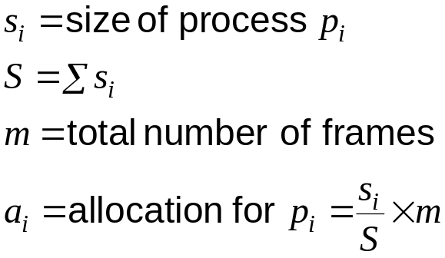
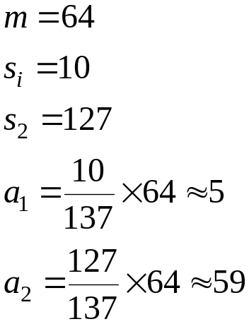
Fixed Allocation
Equal allocation – e.g., if 100 frames and 5 processes, give each 20 pages.
Proportional allocation – Allocate according to the size of process.
Operating System Concepts

Slide 22
Priority Allocation
Use a proportional allocation scheme using priorities rather than size.
If process P_{i} generates a page fault,
  select for replacement one of its frames.
  select for replacement a frame from a process with lower priority number.
Operating System Concepts

Slide 23
Global vs. Local Allocation
Global replacement – process selects a replacement frame from the set of all frames; one process can take a frame from another.
Local replacement – each process selects from only its own set of allocated frames.
Operating System Concepts

Slide 24
Thrashing
If a process does not have “enough” pages, the page-fault rate is very high. This leads to:
  low CPU utilization.
  operating system thinks that it needs to increase the degree of multiprogramming.
  another process added to the system.
Thrashing ≡ a process is busy swapping pages in and out.
Operating System Concepts

Slide 25

Thrashing Diagram
Why does paging work?
Locality model
  Process migrates from one locality to another.
  Localities may overlap.
Why does thrashing occur?
Σ size of locality > total memory size
Operating System Concepts

Slide 26
Working-Set Model
Δ ≡ working-set window ≡ a fixed number of page references
Example: 10,000 instruction
WSS_{i} (working set of Process P_{i}) =
total number of pages referenced in the most recent Δ (varies in time)
  if Δ too small will not encompass entire locality.
  if Δ too large will encompass several localities.
  if Δ = ∞ ⇒ will encompass entire program.
D = Σ WSS_{i} ≡ total demand frames
if D > m ⇒ Thrashing
Policy if D > m, then suspend one of the processes.
Operating System Concepts

Slide 27
Keeping Track of the Working Set
Approximate with interval timer + a reference bit
Example: Δ = 10,000
  Timer interrupts after every 5000 time units.
  Keep in memory 2 bits for each page.
  Whenever a timer interrupts copy and sets the values of all reference bits to 0.
  If one of the bits in memory = 1 ⇒ page in working set.
Why is this not completely accurate?
Improvement = 10 bits and interrupt every 1000 time units.
Operating System Concepts

Slide 28

Page-Fault Frequency Scheme
Establish “acceptable” page-fault rate.
  If actual rate too low, process loses frame.
  If actual rate too high, process gains frame.
Operating System Concepts

Slide 29
Other Considerations
Preparing
Page size selection
  fragmentation
  table size
  I/O overhead
  locality
Operating System Concepts

Slide 30
Other Consideration (Cont.)
Program structure
  Array A[1024, 1024] of integer
  Each row is stored in one page
  One frame
  Program 1 for j := 1 to 1024 do
  for i := 1 to 1024 do
  A[i,j] := 0;
  1024 x 1024 page faults
  Program 2 for i := 1 to 1024 do
  for j := 1 to 1024 do
  A[i,j] := 0;
  1024 page faults
I/O interlock and addressing
Operating System Concepts

Slide 31
Demand Segmentation
Used when insufficient hardware to implement demand paging.
OS/2 allocates memory in segments, which it keeps track of through segment descriptors
Segment descriptor contains a valid bit to indicate whether the segment is currently in memory.
  If segment is in main memory, access continues,
  If not in memory, segment fault.
Operating System Concepts

